Slide 1
Simulation

Slide 2
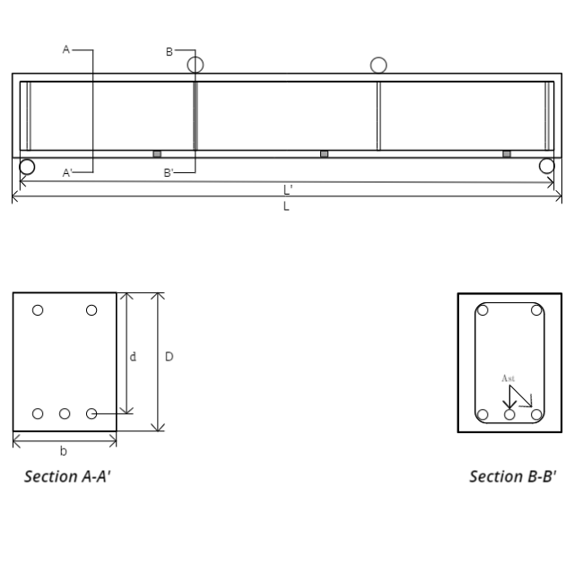
Objective : To study the behavior of Reinforced concrete beam without shear reinforcement.
Materials Required before starting the experiment
RC beam of the shown cross section, casted at least 28 days before the experiment.
f_{ck} of the cement mix used.
Load cell
Hydraulic Jack

Slide 3
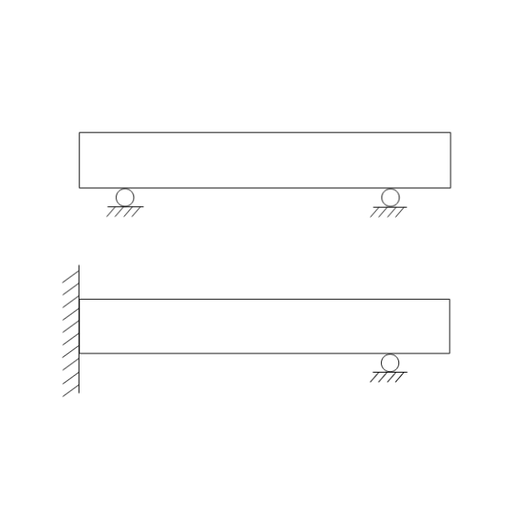
PLACEMENT OF BEAM
Choose the simply supported beam setup to be used in the experiment- (CLICK ON THE CORRECT ONE TO MOVE FORWARD)
CORRECT

Slide 4
INSTRUMENTATION
STEP 2
Choose the four point loading setup to be used in the experiment- (CLICK ON THE CORRECT ONE TO MOVE FORWARD)
CORRECT

Slide 5
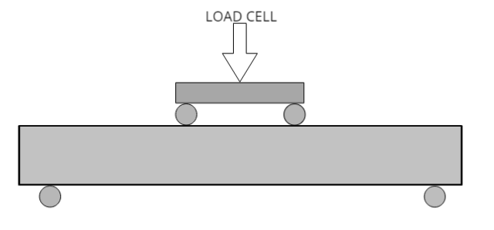
LOADING SET UP OF THE BEAM
After attaching the load cell to the beam, the setup looks like-

Slide 6
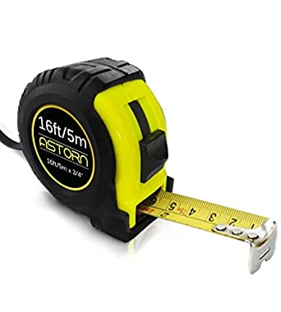
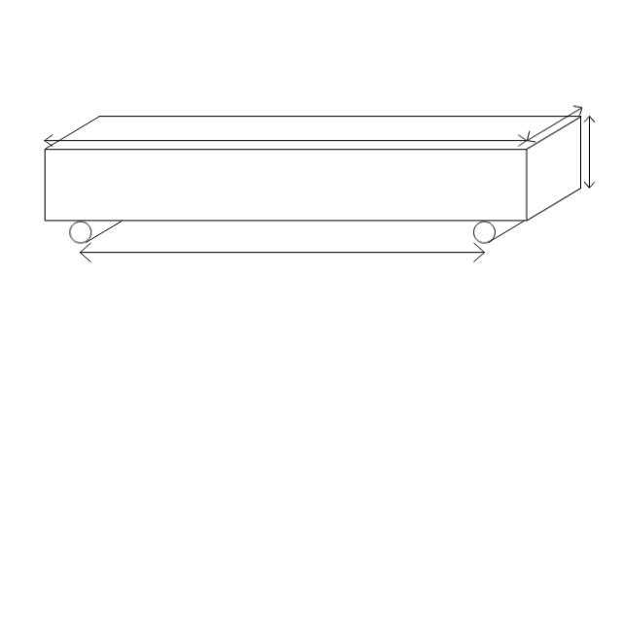
MEASURING DIMENSIONS OF BEAM
Drag the measuring tape to the length, breadth and depth of the beam and then measure the following.
Then drag the measuring tape to the bottom arrow and measure the distance between the two supports.

Slide 7
Measuring Length
This gives the total length(L’) of the beam which will be displayed in a box when measuring Tape is placed as shown below.
Total Length
2012 mm

Slide 8
Measuring Breadth
This gives the breadth(b) of the beam which will be displayed in a box when measuring Tape is placed as shown below.
Breadth
150mm

Slide 9
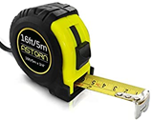
Measuring Depth
This gives the depth(D) of the beam which will be displayed in a box when measuring Tape is placed as shown below.
Depth
205 mm

Slide 10
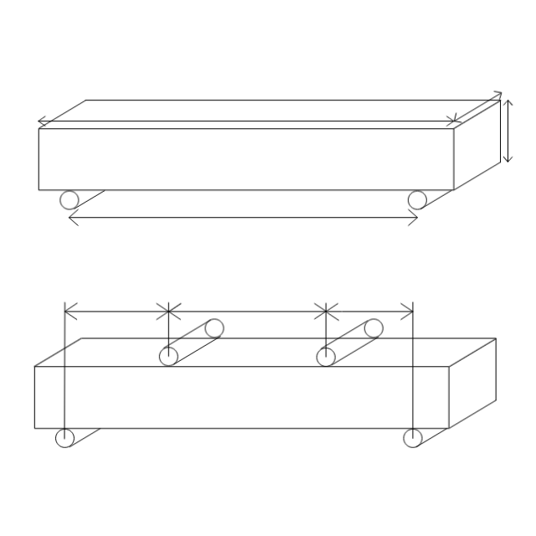
Measuring Dimensions of Beam
Drag the measuring tape to the arrow to note the distance between supports and point of application of load.
Length between the supports
1800 mm
Length between Support and point of application of load
AB
A
B
C
D
BC
CD

Slide 11
Measuring the distance between the supports
Measure the distance between support 1 and 2 when the measuring tape is placed as shown.
AB
603mm

Slide 12
Measuring the distance between the supports
Measure the distance between support 2 and 3 when the measuring tape is placed as shown.
BC
598 mm

Slide 13
Measuring the distance between the supports
Measure the distance between support 3 and 4 when the measuring tape is placed as shown.
CD
599 mm

Slide 14
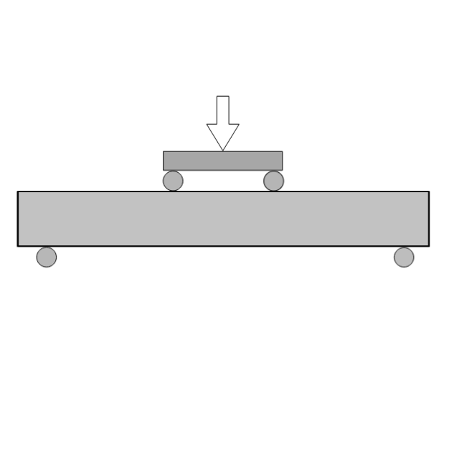
PERFORMING THE EXPERIMENT
LOAD
Click on the button to increase the load.
Pause the application of load when cracks start appearing.

Slide 15
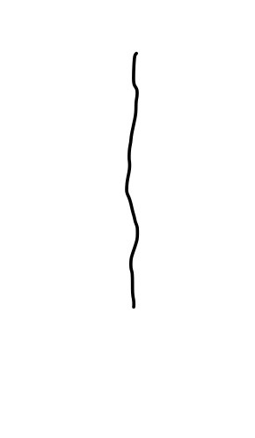
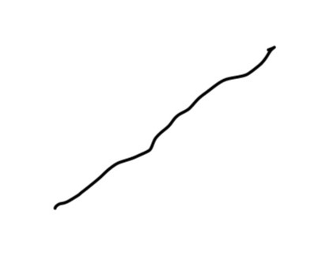
PERFORMING THE EXPERIMENT
LOAD
USE THE MARKER TO MARK THE CRACKS
(TAKE IT TO THE BEAM, CRACKS WILL BE MARKED)
Flexure Shear Crack
Flexure Cracks

Slide 16
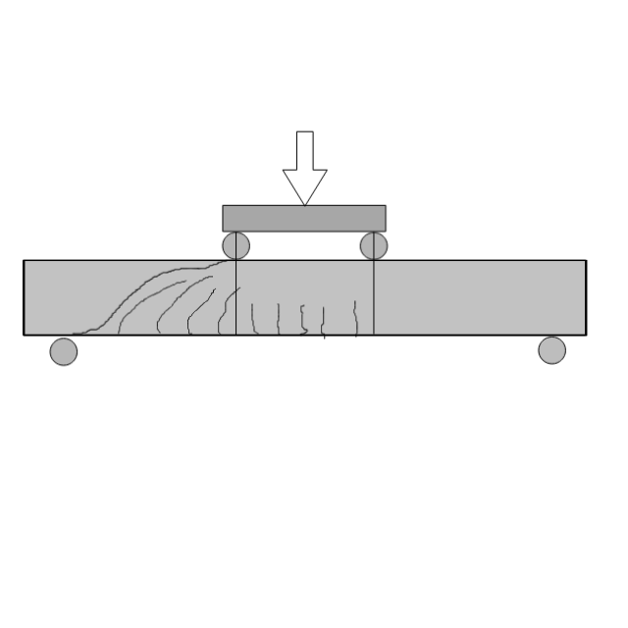
PERFORMING THE EXPERIMENT
AFTER MARKING CRACKS
LOAD
RECORD THE LOAD(FROM LOAD CELL) AND MARK THE SHEAR AND FLEXURE CRACKS.
THE STRAIGHT CRACKS IN THE MIDDLE SHOULD BE FLEXURE CRACKS.
THE BENT CRACKS IN THE TWO SIDES SHOULD BE SHEAR CRACKS.
IF PLACED WRONG THEN ERROR SHOULD BE SHOWN AND THE MARKER SHOULD GO BACK TO ITS INITIAL POSITION.

Slide 17
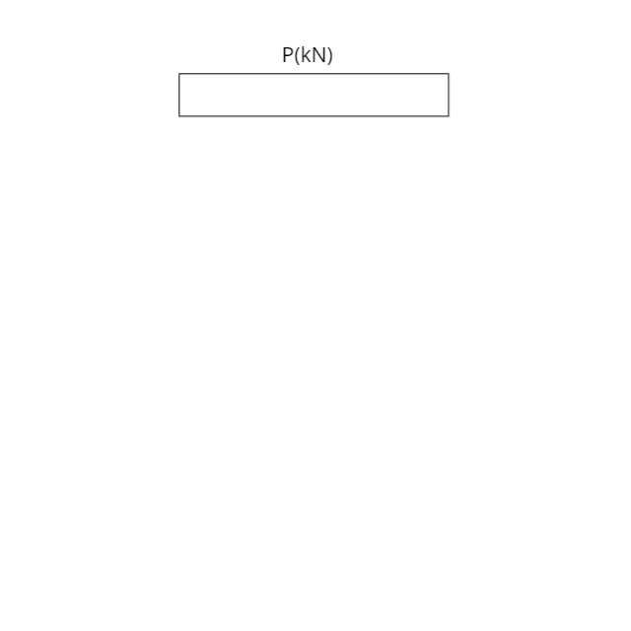
PERFORMING THE EXPERIMENT
6.3 T
Start increasing the load after marking the cracks.
After marking once keep increasing the load till failure or the time when beam fails and shear crack appears as shown in next slide.
Note down the failure load as P.
6.3 T

Slide 18
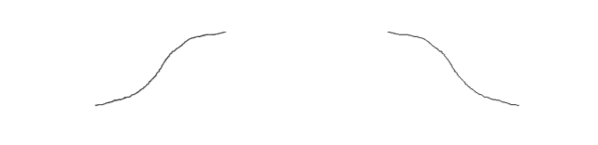
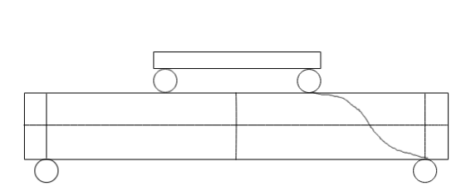
OBSERVATION
Choose the crack which appears.
Left crack
Right Crack
2.Drag the crack to the beam and when placed in vicinity place the crack otherwise drive it back.
Crack placed on beam

Slide 19
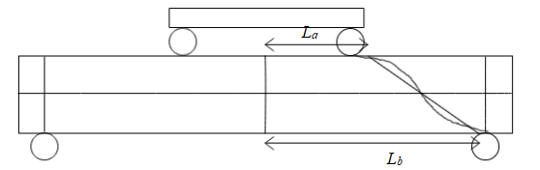
Observation
Measure the length of two distances from the centre-line of the beam when measuring tape is dragged to the given length(Shown in following slides).
Slide the measuring tape to the two arrows and when the measuring tape reaches there show the distance in box.

Slide 20
Measuring L_{a}
Drag the measuring tape to the top arrow as shown and when placed there display the distance in box.
L_{a}
460 mm

Slide 21
Measuring L_{b}
Drag the measuring tape to the top arrow as shown and when placed there display the distance in box.
L_{b}
640 mm

Slide 22
OBSERVATION
Grade of concrete(f_{ck}) = M25(GIVEN)
Mean compressive strength of concrete(f_{cm}) = To be entered
Grade of steel(f_{y}) = Fe500
Mean Yield strength of steel(f_{ym}) = To be entered
Area of tension steel(A_{st}) = 339.29200 mm²
Length of Beam Between Supports(L/3) =. 1800 mm
Depth of Beam(D) = 200 mm
Width of Beam(b) = 150 mm
Effective depth of beam (d) = 169 mm
Length of crack from Centre (L_{a} ) = 460 mm
Length of crack from Centre (L_{b} ) = 640 mm

Slide 23

CALCULATION
Taking:
Load applied at failure: P
Overall depth of beam: D
Breadth of beam: b
Density of reinforced concrete: $ρ_{conc}$
Shear force applied at failure: $V_{obs}$
Volume of the approximate section considered: V
Length of crack from centerline of the beam at top: L_{a}
Length of crack from centerline of the beam at bottom: L_{b}
Taking the approximate section to calculate self-weight as trapezium the volume of the same is:
$V=\frac{\left(L_{a}\right)\left(L_{b}\right)bD}{2}$(L = 900 mm)
$Shear Force observed at Failure\left(V_{obs}\right)=\frac{P}{2}+ρ_{conc}V$($ρ_{conc}=24)$
Observed value of shear strength$\left(V_{obs}\right)$= 59.606 kN
V_{pred} : Ast/bd = 1.33843
F_{ck} = M25
V_{pred} = 18.10355 kN
Comparing the two values gives us the factor of safety(FOS). The Factor of safety is defined as the ratio of V_{obs} and V_{pred}.
FOS= V_{obs}/ V_{pred}

Slide 24
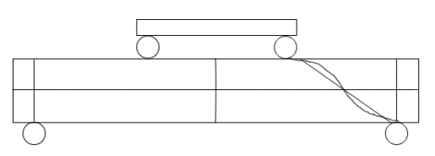
RESULTS
The Factor of Safety for the experiment is = 3.2931
The load at failure is = 59.606 kN
The Predicted value of the beam section is =18.10355 kN
6.3 T
Failure Load(kN)(obs)
59.606 kN
Failure Load(kN)(Theo.)
18.1035 kN
FOS
3.2931

